Slide 1
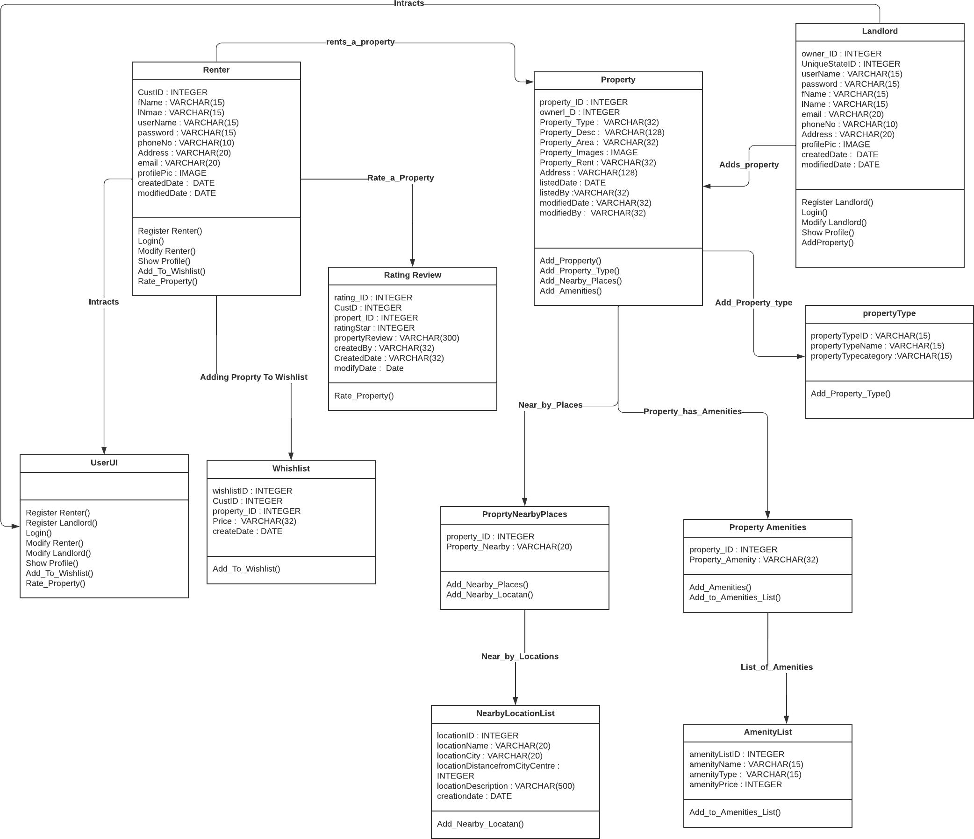
Class Diagram(StayMatch)

